Slide 1

Housing Project
Submitted by
Neha

Slide 2
Introduction
A Us based housing company has decided to enter the Australian market. The company is using data analytics to purchase house at a price below their actual values and flip them at a higher price.For the same purpose, the company has collected a data set from the sale of houses in Australia.So we will build a model using machine learning in order to predict the actual price of the properties. So we will model the price of the houses with the independent variables. This model will then be used by the management to understand how exactly the prices vary with the variables.

Slide 3

Importing the dataset
Firstly we imported the dataset (train.csv )in the pandas' data frame.
Created an instance named df for the dataset.
We have 1168 rows and 81 columns in the dataset.

Slide 4
Identifying the type of problem
We have seen that 'SalePrice' is the dependent target variable in the dataset.
We have seen in the dataset that the SalePrice is in a continuous in nature.
Thus it is a Linear Regression problem.

Slide 5
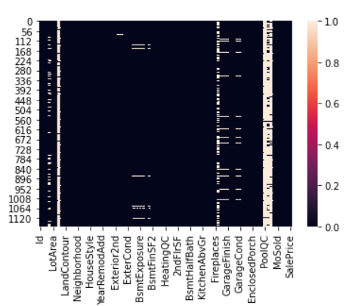
Exploratory Data Analysis(EDA)
Firstly we have done the basic analysis of the data like:- shape,dtypes, isnull.etc
By checking the null values we can see that null data is present in our dataset.
We have used heatmap to see the null values present in the dataset.

Slide 6
Statistical Summary
We got a lot of information from the statistical summary of the data.
After observing the statistical table, we have seen that many outliers are present in many columns of the dataset.
Their is huge difference between the range of each column.

Slide 7
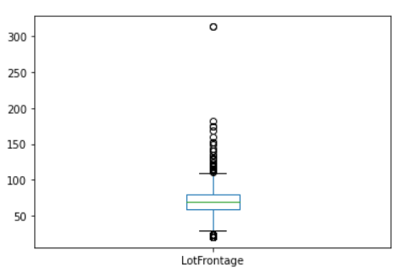
Univariate Analysis
Using Boxplot
We have used boxplot for each of the column.Here we have a boxplot of the column LotFrontage
In this plot we can see that most of the data points are below the minimumand above the maximum, which are the outliers.
Where Q1,Q3 and median all are lying in the range of 50 to 120.

Slide 8
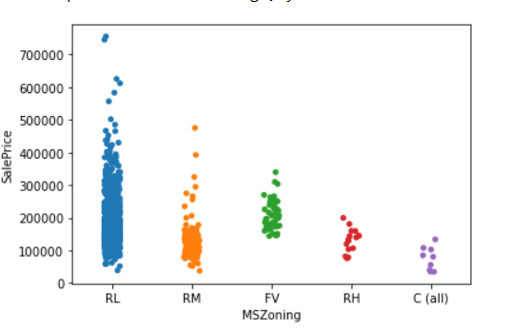
Bivariate Analysis
Using Strip plot
We have used strip plot for bivariate analysis to see the relation of each column with the target column.
Here is a strip plot of the column MSZoning with the SalePrice.
We can clearly understand the saleprice of each type of MSZoning from the plot.
We can see the highest sale price, lowest saleprice of each type easily.

Slide 9
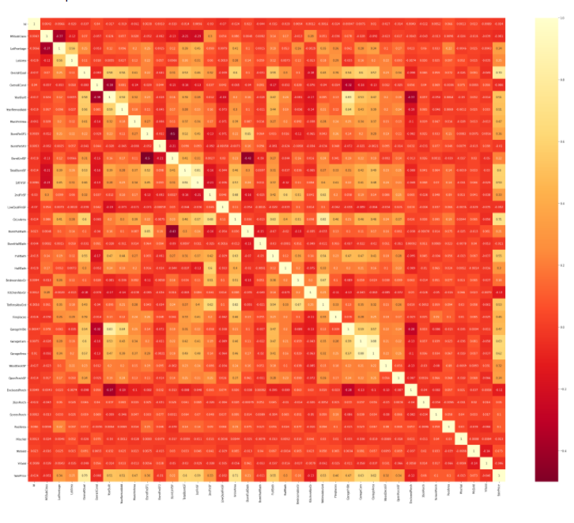
Multivariate Analysis
In the correlation matrix, we can see the relation of each column with all the other columns.
We can see the correlation matrix in the plot.

Slide 10
From the correlation plot, we can see the correlation of the target variable with each column with the values.
But the plot is soo messy that we are not able to read the information from the plot.
So we use a code sort values to get all the values in the form of a list.
Now we can easily study the correlation of each column.
The variables which has correlation value less than 0.01 are weakly correlated, while the variables which has value more than 0.01 are strongly correlated with the SalePrice column.

Slide 11
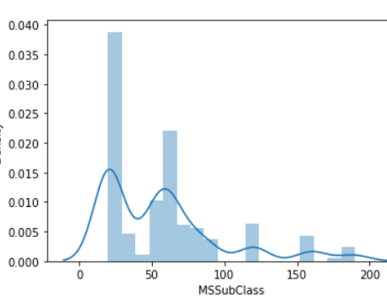
Checking Skewness
Here we have checked the skewness for each column of the dataset.
Here we have the plot of the MSSubclass column, here we can see that all the curves carry skewness, not normally distributed.
we will remove the skewness later on using the appropriate method.

Slide 12
Data Cleaning
Handling the missing values
Dropping the columns
As we have already seen that we have many missing values in our dataset, So we have treated the missing values using median because our dataset carry skewness.
So now we are dropping the highly negatively correlated columns from our dataset .The columns are OverallCond, YearBuilt, BsmtUnf, EnclosedPorch, YrSold, GarageYrBlt.

Slide 13
Label Encoding
Removing outliers
We have many columns present in string format So we have changed them in integer format by applying Label Encoding on it.
From the univariate and bivariate analysis, we have seen that many outliers are present in many columns.
But when we try to remove the outliers using Zscore and IQR we observed a high loss of data, so we do not remove outliers from the dataset.

Slide 14
Removing Skewness
We have seen that skewness is present in many columns, we have also checked the skewness using the skew function.
For removing skewness we have split our data in the form of the target variable and independent variable.
After that, we have removed the skewness by using the power transformer method.

Slide 15
Creating Train Test Split: Here we have split our data for training and testing in a 7:3 ratio.
Random State: We have chosen 52 as the random state for our models.

Slide 16
Finding Best Algorithm using multiple models
We have used different regression models listed below:
LinearRegression()
DecisionTreeRegressor()
SVR()
KNeighborsRegressor()
Lasso(alpha=0.0001)
Ridge(alpha=0.0001)

Slide 17
Evaluation Metrics: It's a regression problem we have used r2_score, mean absolute error, mean squared error, and root mean squared error are the evaluation metrics used.

Slide 18
After using all the models we are getting different errors and different r2_score values for all the models.
We are getting the highest accuracy with the Linear Regression model.
But the accuracy we are getting can be due to overfitting sp we go for cross-validation.
Checking for cross-validation: By checking the cross-validation we have observed that the minimum difference between cross-validation and accuracy score is for the Linear Regression model.

Slide 19
Hyper Parameter Tuning
Now we will perform hyperparameter tuning to get the best parameter for our models.
SVR: After performing hyperparameter tuning for SVR we have observed that the accuracy is improved much more which now 88%.
DecisionTreeRegressor: For Decision tree regressor we have observed that the accuracy is improved but very little which is 70% now.
KNeighborsRegressor: For Kneighbors Regressor the accuracy is improved little bit which is now 81%.
So we are getting highest accuracy with the SVR after hyperparmeter tuning so this is our best model among all the models.

Slide 20

Saving the Best Model: As we have seen that after hyperparameter tuning we are getting the highest accuracy with the SVR model so we have saved this model as our best model.
Now we will use this model to make predictions for the test data,

Slide 21

Thanks.

